Slide 1


Data Science Minor Project: Allegheny County Employee Salaries 2022
This comprehensive data science project analyzes Allegheny County employee records for 2022, focusing on workforce dynamics, salary distributions, and employment trends. Through detailed preprocessing and statistical analysis, the project reveals insights into hiring patterns, termination trends, and compensation structures across departments.
The analysis examines monthly variations in employment, identifies peak hiring periods, and offers valuable insights for future workforce planning and policy-making. The project combines rigorous data analysis with visual representations to highlight key patterns and observations.
by Rahul Rajput

Slide 2




Project Overview and Methodology
Dataset Source
Data Preprocessing
Analysis Approach
Comprehensive Allegheny County employee records containing joining data (1968-2022) and termination data (2022), accessed from data.gov catalog.
Thorough cleaning, handling of missing values, date format standardization, and validation against source data.
Statistical examination of monthly patterns, identification of peak periods, and visualization of workforce trends.

Slide 3
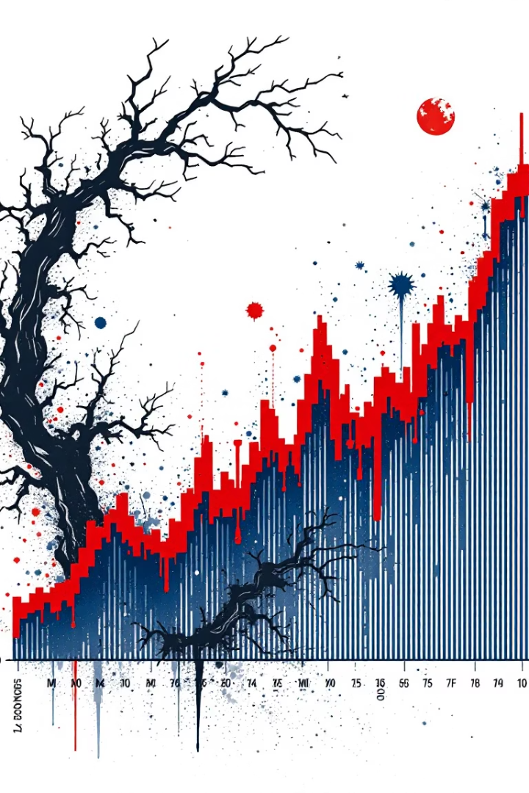



Employment Trend Analysis
Hiring Patterns
Increasing trend in employee hires during organizational expansion periods, with notable peaks in specific years.
Termination Trends
Spikes in terminations corresponding to organizational restructuring and economic conditions.
Monthly Variations
Distinct patterns in workforce changes throughout the year, revealing organizational dynamics.

Slide 4








Employee Performance Insights
Overtime Pay
Incentive Pay
Significant overtime concentrated in high-demand roles, indicating critical operational contributions.
Performance-based compensation highlighting exceptional employee contributions.
Growth Patterns
Top Departments
Performance trends showing departmental expansion and contraction.
Leading departments in total compensation, reflecting organizational priorities.

Slide 5
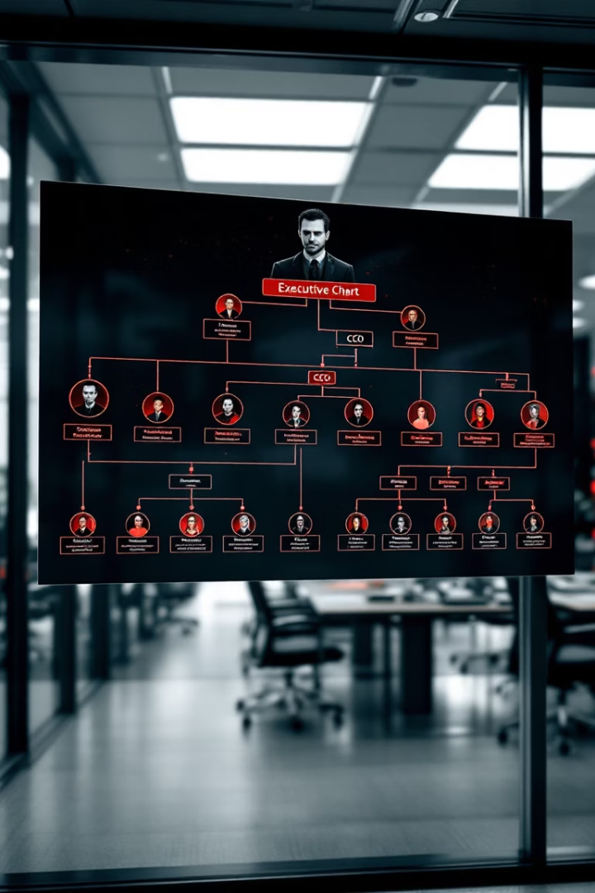
Job Role Analysis
Highest-Paying Roles
Role Distribution
Analysis of employee concentration across different job categories, highlighting organizational structure.
Managerial and technical positions command top salaries, reflecting specialized expertise requirements and strategic importance.
Career Progression
Patterns in role advancement and salary growth, providing insights into career development paths.

Slide 6
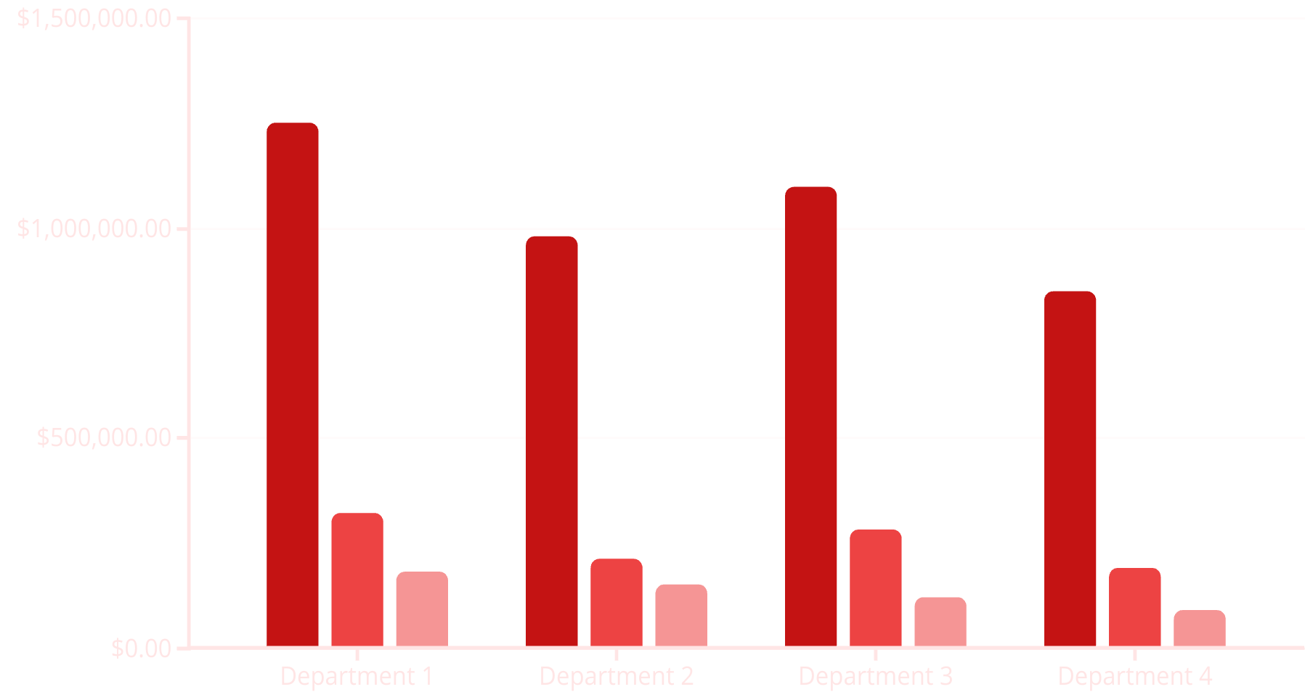
Compensation Analysis
Regular Pay
Overtime Pay
Incentive Pay
The compensation analysis reveals significant variations across departments. Department 1 leads in all pay categories, with the highest regular, overtime, and incentive compensation. Regular pay constitutes the largest portion of total compensation across all departments, followed by overtime and incentive pay.
These patterns reflect departmental priorities, operational demands, and performance recognition strategies within the organization.

Slide 7








Diversity and Equity Findings
Pay Equity Goals
Recommendations for addressing observed disparities
Demographic Analysis
Distribution patterns across departments
Gender Pay Gap
Male employees earning more on average
Ethnic Disparities
Variations in compensation across ethnic groups
The analysis identified notable pay gaps based on gender and ethnicity, with male employees and certain ethnic groups earning higher salaries on average. These findings highlight important areas for diversity and equity initiatives within the organization.

Slide 8

Financial Impact Analysis
$X.XM
X%
Total Payroll
Overtime Ratio
Annual expenditure across all departments
Proportion of total compensation
$Y.YM
Department 1 Spend
Largest departmental allocation
The financial analysis reveals significant expenditure patterns across the organization. Regular pay dominates the overall compensation structure, with notable contributions from overtime and incentives. Department 1 accounts for the largest share of payroll expenses, reflecting its operational significance within the organization.

Slide 9



Future Research Opportunities
Predictive Analytics
Employee retention models and workforce planning
Compensation Optimization
Algorithms for fair and efficient pay structures
Diversity Initiatives
Data-driven policies for improved inclusion
The project identifies several promising avenues for future research, including predictive analytics for employee retention, compensation optimization algorithms, and data-driven diversity initiatives. Additional opportunities include performance correlation studies, departmental efficiency analyses, and integration with organizational systems for real-time insights.

Slide 10





Conclusion and Implementation
Key Findings
Identified employment trends and compensation patterns
Insights
Revealed organizational dynamics and potential areas for improvement
Applications
Practical implementations for workforce planning and policy development
Next Steps
Recommendations for continued analysis and organizational action
This comprehensive analysis of Allegheny County employee data provides valuable insights into workforce dynamics, compensation structures, and employment trends. The findings can inform strategic decision-making, policy development, and resource allocation within the organization.
By leveraging these insights and pursuing the identified future research opportunities, the organization can enhance its workforce management practices, address equity concerns, and optimize its compensation strategies for improved operational efficiency and employee satisfaction.

